Slide 1

TOYS FOR AUTISTIC KIDS

Slide 2
College Name
SRM Institute of Science and Technology
Jadavpur University

Slide 3
Faculty guide details
NAME Dr E VIJAYARAGAVAN.
EMAIL ID vijayare@srmist.edu.in .
DISCIPLINE Mechanical Engineering.
YEAR Not applicable.
MOBILE 9884214710.

Slide 4

Team member details

Slide 5
TEAM MEMBER 1
NAME Pushpal Das .
EMAIL ID pushpaldas2001@gmail.com .
DISCIPLINE Electronics and Communication Engineering .
YEAR 3rd year .
MOBILE 8910497557 .

Slide 6
TEAM MEMBER 2
NAME Abhishek Sarkar.
EMAIL ID abhisrkr007@gmail.com .
DISCIPLINE Electronics and Teleommunication Engineering.
YEAR 3rd year.
MOBILE 6290782054.

Slide 7
TEAM MEMBER 3
NAME Santhosh Kumar. R.
EMAIL ID klt.santhosh2002@gmail.com .
DISCIPLINE Electronics and Communication Engineering.
YEAR 3rd year.
MOBILE 9677867812.

Slide 8

TEAM MEMBER 4
NAME Suriya Devalan AR.
EMAIL ID as5539@srmist.edu.in.
DISCIPLINE Mechanical Engineering.
YEAR 3rd year.
MOBILE 8072137976

Slide 9
AUTISM
Autism spectrum disorder , or autism, is a broad term used to describe a group of neurodevelopmental conditions.
These conditions are characterized by differences in communication and social interaction.
People with ASD often demonstrate restricted and repetitive interests or patterns of behaviour.
ASD is found in people around the world, regardless of race and ethnicity, culture, or economic background.
A study of 8-year-olds in 11 locations throughout the United States found a 4.3 to 1 boy-to-girl ratio Trusted Source in.

Slide 10
CAUSES OF AUTISM
having an immediate family member who’s autistic.
genetic mutations.
fragile X syndrome and other genetic disorders.
being born to older parents.
low birth weight.
metabolic imbalances.
exposure to heavy metals and environmental toxins.
a history of viral infections.
fatal exposure to the medications valproic acid or thalidomide.

Slide 11
TREATMENT
behavioural therapy.
play therapy.
occupational therapy.
physical therapy.
speech therapy.

Slide 12
TREATMENT
Massages, weighted clothing and blankets and meditation techniques, may also help some autistic people manage symptoms.

Slide 13
AWARENESS
April 2 is World Autism Awareness Day April has also become known as Autism Awareness Month in the United States.
However, many community advocates have rightly called for the need to increase awareness about ASD year-round, and not just during 30 select days.
The Autism Society of America and other advocates have even proposed that April be designated Autism Acceptance Month instead.

Slide 14
AUTISM ON KIDS
Autistic children may not reach the same developmental milestones as their peers, or they may demonstrate the loss of previously developed social or language skills.
Autistic children may also engage in repetitive behaviours, have difficulty sleeping or compulsively eat non-food items.
Many resources are available to help autistic children as well as their loved ones.
Local support groups can be found through the national non-profit The Autism Society of America

Slide 15

RESOURCES
Name of the organization | Spokesperson | Contact number
Sunshine Autism Care. | Nilanjana Rambothu | +91 98318 29177
Happy to learn autism. | Susmita Das Bhattacharya | +918017784551
Special educator for special child. | Pijush Ray | +917980171377
Jadavpur Manogyan Rehabilitation Programme for Disabled Children. | Iti Saha | +919836430248
Kolkata Anubhuti. | Gopa Mukherjee | +919674340287
Our team would like to acknowledge the following organizations for their ample amount of time they have contributed for collecting data and information for our observatory and experiment purposes .

Slide 16
Questions asked What are the problems faced on this particular disease, autism?
“The brain isn't mature as a result grasping power, gross motor and fine motor is not properly developed. As a result, basic activities such as holding a pencil, scribbling, dot joining etc. becomes difficult for them to perform. As a result, writing skill isn't properly developed.
Autism can be due to a number of reasons, pregnancy stress of the mother, or pressure on the brain during delivery etc.”
“ In many cases fine motor problem is widely observed among the majority kids with autism. For example, problem in how to hold a pencil is a common issue noticed among such kids. In some cases, kids with autism find it difficult to quickly follow or execute instructions. With age, the child might develop speech problems. A common characteristic noticed among these children that they are antisocial and love their own company, they prefer solitude.”
“In this condition the children suffer Neuro problem due to which they have issue in gripping objects (pen, pencil etc.) and hence they face difficulty in writing. They face fine motor problem and gross motor problem.”

Slide 17
Questions asked What is the range of age group being affected to this particular problem?
“Inborn”
“Pijush Ray and his team have observed that autism is not only inborn but can also develop after certain age. For example, there are cases where a child develops the condition after 7 to 8 years of age.”
“Inborn, autism can be detected even within six months of birth. With age there can be onset of speech issues.”

Slide 18
Questions asked Opinions on the change for improving an autistic kid vision and reading problems.
“Counselling, physically helping them to grip objects and use them. Massaging the hands and fingers, use of some sensory stimuli such as sandpaper to improve the grasping power. These help in improving this condition to some level.”
“Lifelong support”
“Audio visual aids help the children understand topics and instructions in a better and easier way.”

Slide 19
Questions asked How can a robotic hand would meet the contrast of attraction between a kid with autism and a toy, what makes it more attractive for the kid to work on it?
“The things to be kept in mind while making the TML (teaching learning material) is that it should be low cost and sturdy device. It should be visually appealing with the use of audio, if possible, to grow interest among the autistic kids. Inputting audio aid(music)”
“Visually appealing, with lights and colours would be interesting for these children. (Very important for their eye contact)
“Visual inputs such as lighting in the device can be interesting to them. Also using audio can help them understand and find it interesting.”
These kids are sensitive towards touch, hence adding different textures (soft texture, rough texture) for them to feel/touch would help them get fascinated and interested.”

Slide 20
A C K N O W L E D G E M E N T
We specially thank, Nilanjana Rambothu , Founder and Director of Sunshine Autism Care and consultant RCI holder in Special education (ASD) , for the time she has contributed on this project.

Slide 21
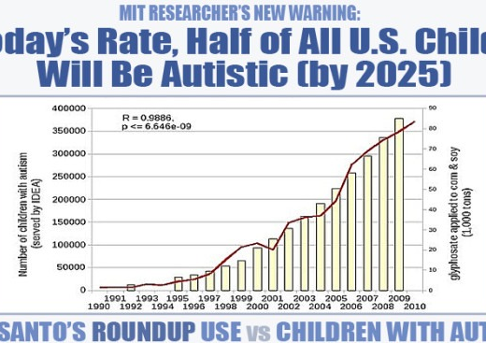
GRAPHICAL ANALYSIS
Trends over time in the number of children with autism according to the IDEA.

Slide 22
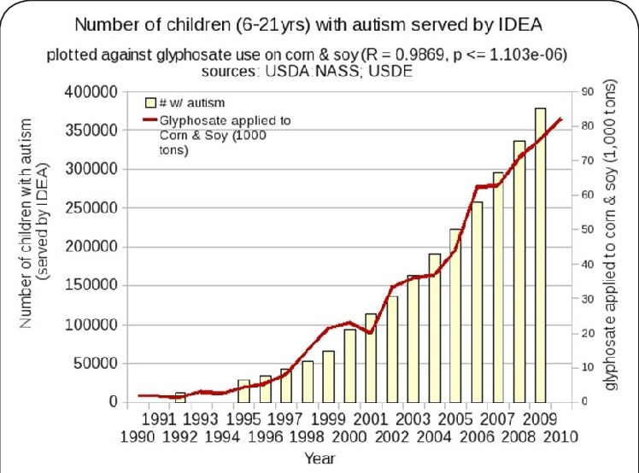
GRAPHICAL ANALYSIS
Trends over time in the number of children with autism according to the IDEA.

Slide 23
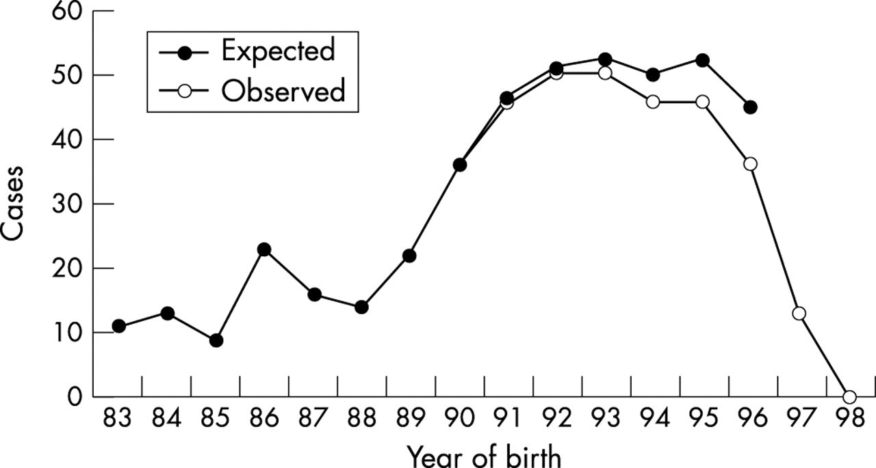
GRAPHICAL ANALYSIS
Prevalence of autism and parentally reported.

Slide 24
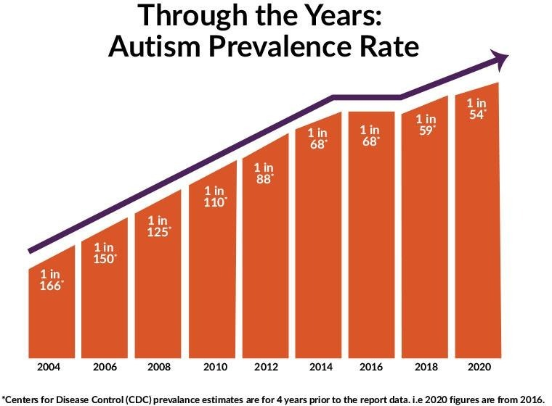
GRAPHICAL ANALYSIS
Prevalence of Autism Increases by 10%, to 1 in 54 Children | Southwest Autism Research & Resource Center.

Slide 25
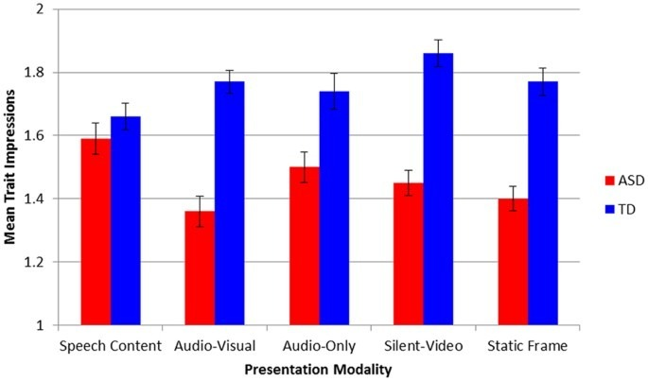
GRAPHICAL ANALYSIS
Neurotypical Peers are Less Willing to Interact with Those with Autism based on Thin Slice Judgments | Scientific Reports.

Slide 26
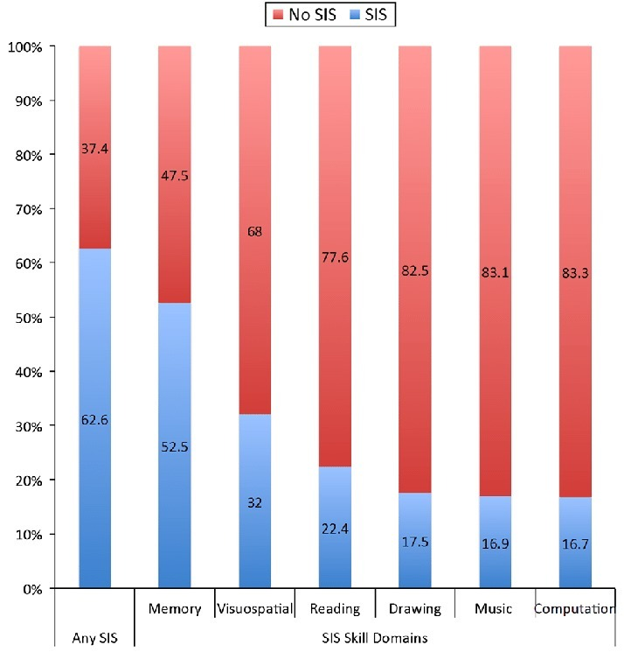
GRAPHICAL ANALYSIS
Graph showing the percentage of the sample from Study 1 with and without reported talents, or ''Special Isolated Skills'' , in any domain and in each of the six ADI-R SIS domains separately.

Slide 27
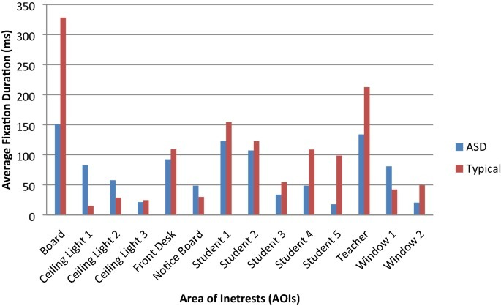
GRAPHICAL ANALYSIS
Impact of mainstream classroom setting on attention of children with autism spectrum disorder: an eye-tracking study | SpringerLink.

Slide 28
C O N C L U S I O N
As by the research we undergone and by the resources we can come to the point that autistic kid faces lots of problems with their sensory nerves and their gross motor and fine motor and so on. We are working on a project with an idea of making the kid to learn by making the kid to hold an artificial hand (robotic arm) which has the ability to track the pattern of the kid’s hand movement and to guide the kid to move their hand in the right way to complete the pattern by interactive methods. We hope our idea would bring the changes in the kid positively.

